Slide 1
Intro to Neural Nets
Class Logistics and Introduction

Slide 2

Session Agenda
1. INTRO & LOGISTICS
Who am I? Why should you care what I have to say?
Schedule and evaluation criteria.
Delivery format, etc.
2. WHAT IS DEEP LEARNING?
How did we get here? When are these techniques this useful?
Examples of good, useful, and problematic applications
3. THE BASICS & A FIRST EXAMPLE
What is a neural network?
How does it work?
Training our first neural network.

Slide 3




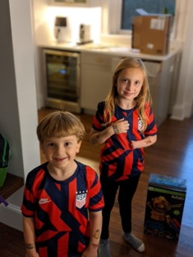






About Me

Slide 4
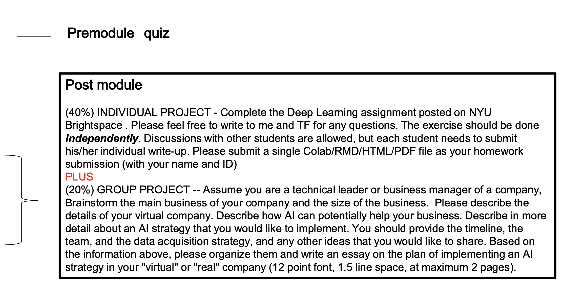
Grading & Evaluation
30%
40%
30%
30%

Slide 5
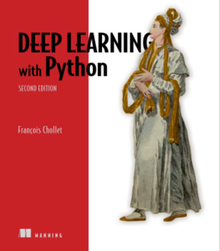
Textbook
Chollet, François. (2021). Deep Learning with Python (2nd Edition). Manning Publications Co. ISBN-13: 978-1617296864. https://www.manning.com/books/deep-learning-with-python- second-edition

Slide 6

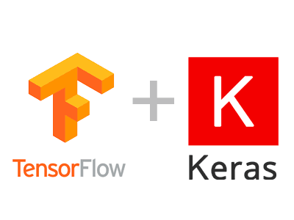


We Will Be Using Keras…
SOFTWARE CONFIGURATION
You can access Google Colab at https://colab.research.google.com. You should have setup a colab account already.

Slide 7
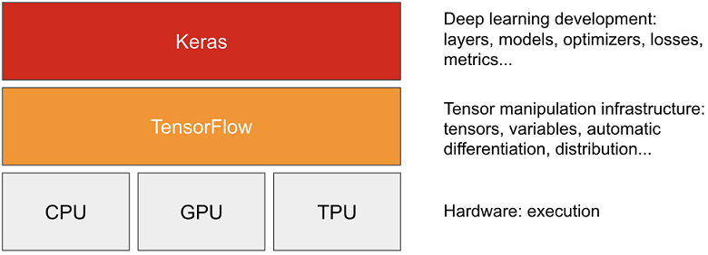
Keras and Tensorflow
1. Tensorflow
A Python platform for working with tensors, implementing automatic differentiation, providing access to repositories of (well-known) pre-trained models.
2. Keras
A higher-level API that wraps common usage patterns with Tensorflow functions, pre-defined loss functions, optimization algorithms, etc.
Keras simplifies data scientists’ interaction with Tensorflow.

Slide 8
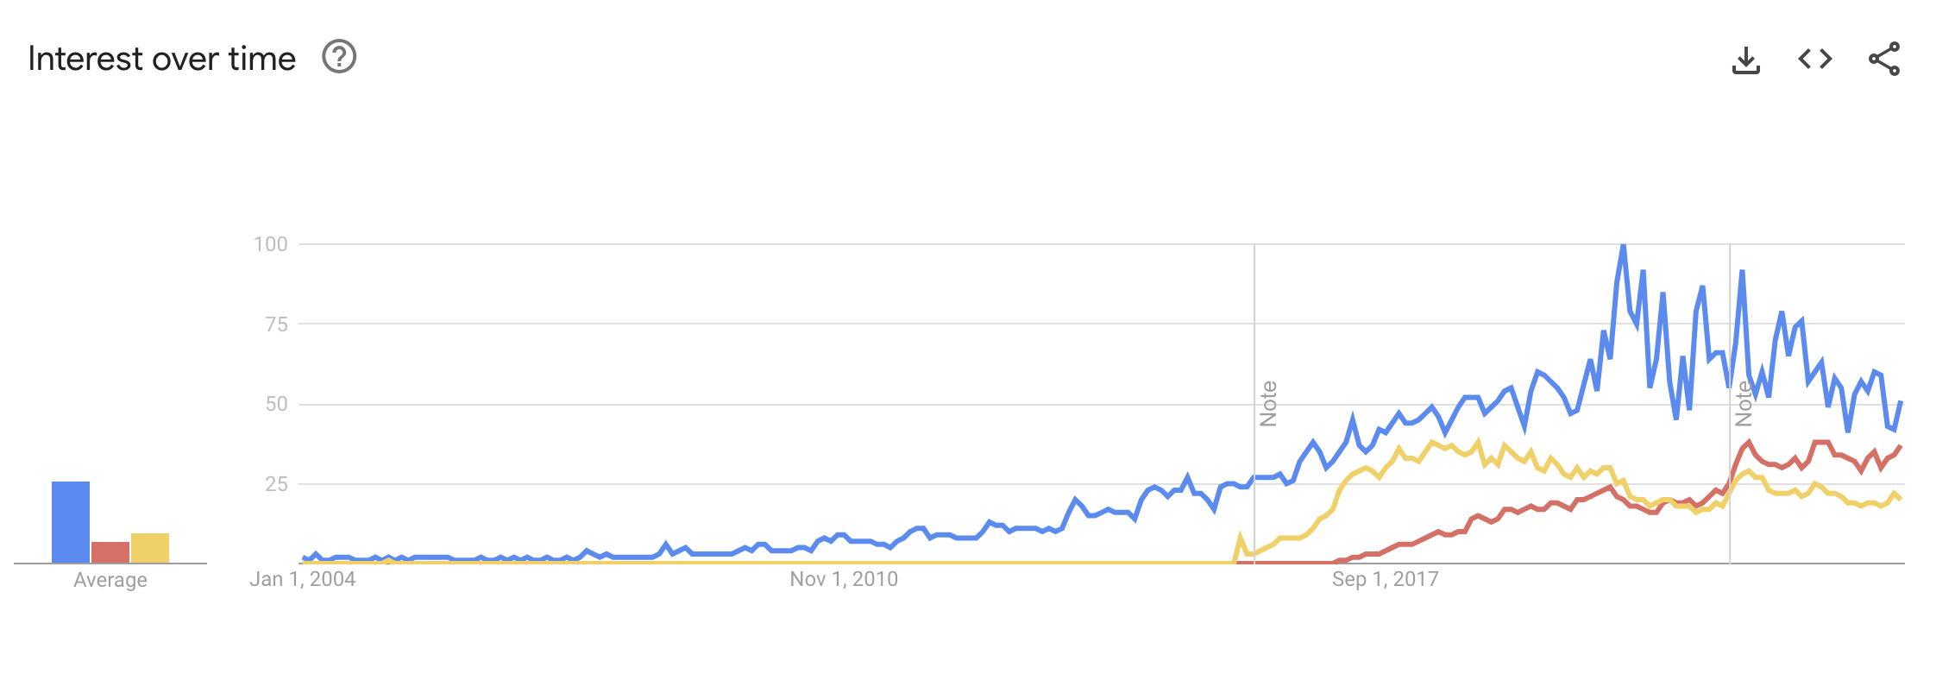
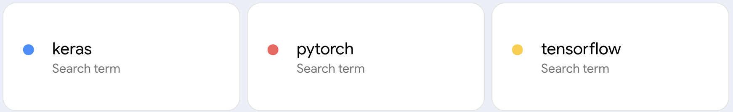
Why Keras?

Slide 9

Course
LECTURE AND DISCUSSION
For each session block over the next two days, I will begin by presenting concepts, describing logic, discussing implementation considerations.
HANDS-ON EXERCISES
The latter half of each session will be dedicated to hands on examples in Colab notebooks, where I will walk through the code and explain the logic of what we are doing, allow you to ask questions, etc.

Slide 10
Question: What is ‘Deep’ (vs. Shallow) Learning?

Slide 11
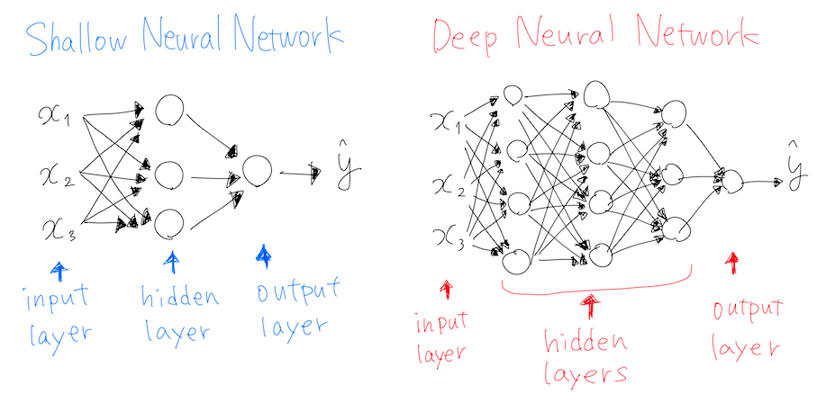
What is ‘Deep’ Learning?
Notes:
Most other ML approaches are shallow (they map inputs to outputs in a single layer / transformation, or few layers). Deep here refers to the fact that there is a layered approach to transformation. 4 or more layers, generally, by which transformations feed into other transformations, enabling flexible representation of mappings.

Slide 12
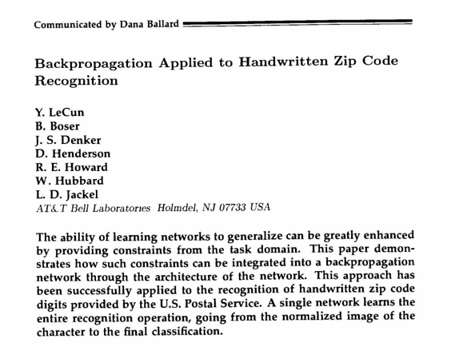
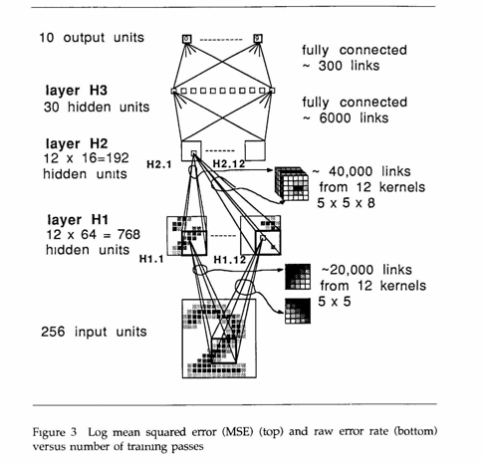
A Very Simple Application

Slide 13
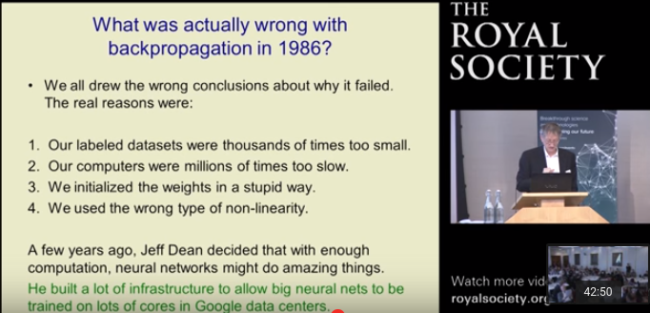
Then It Shuffled Along for Decades…
Now…
Notes:
Vanishing gradient problem,

Slide 14
Why Did Deep Learning Take Off?

Slide 15

Video Games
Notes:
GPUs were developed to handle parallel processing capabilities needed for high end video game graphics. Turns out those same designs were useful for training a neural net (parallel computation, through vectorization of code). Basically, training a deep net involves performing a shitload of matrix multiplications. It’s better if we can do those calculations in parallel rather than sequentially. GPUs (and now TPUs) enable a ton of parallelization, speeding up the calculations.

Slide 16
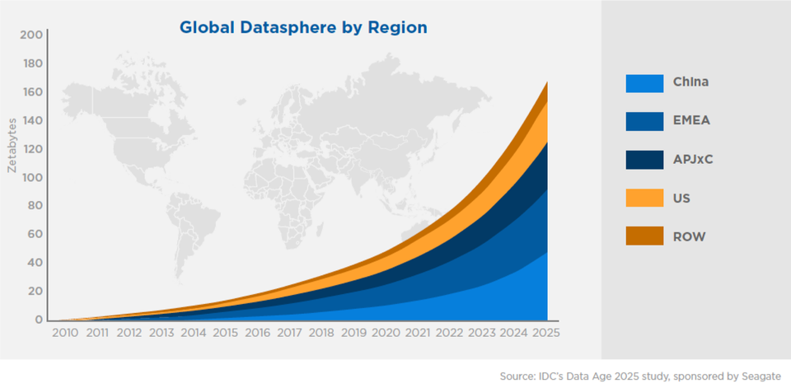
Data

Slide 17
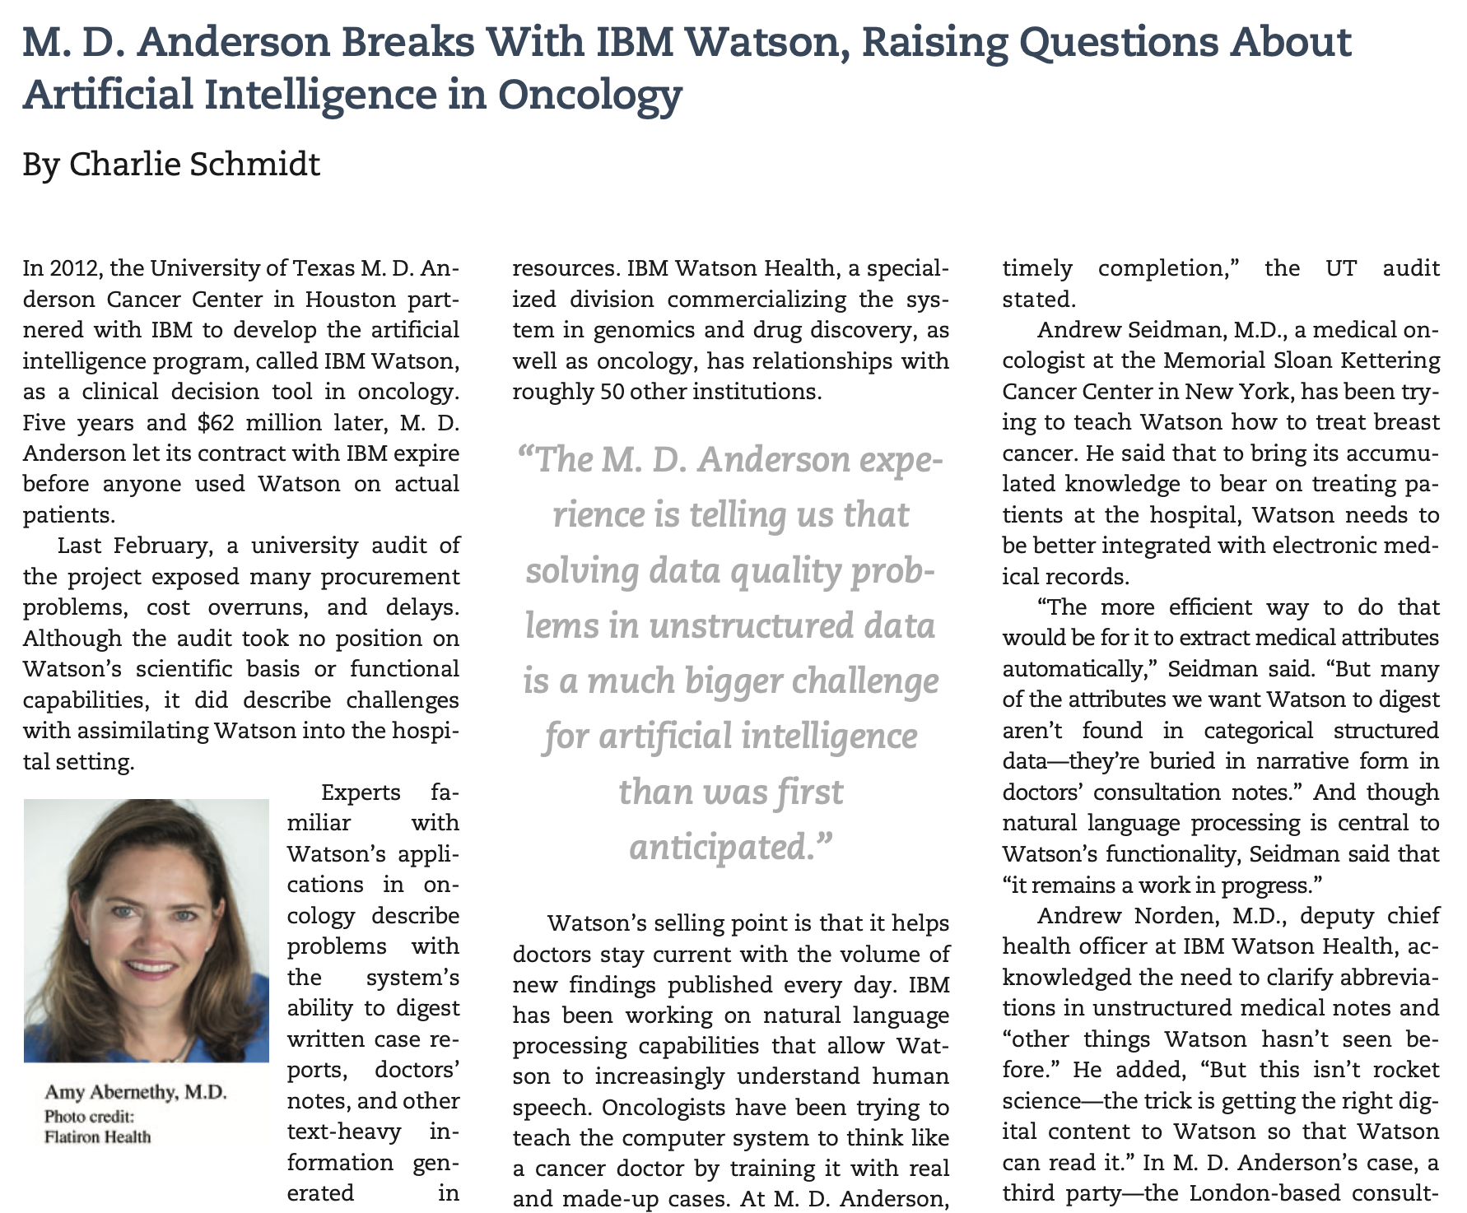
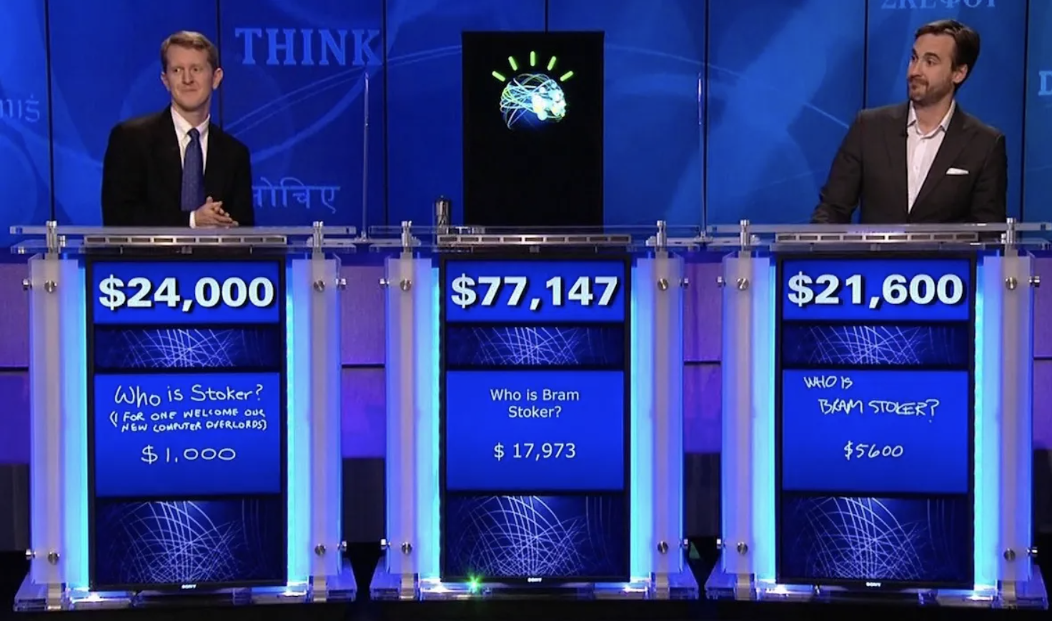
Caveat: Lots of Data != Good Data

Slide 18
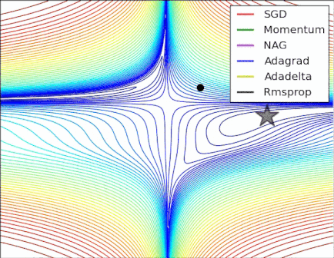
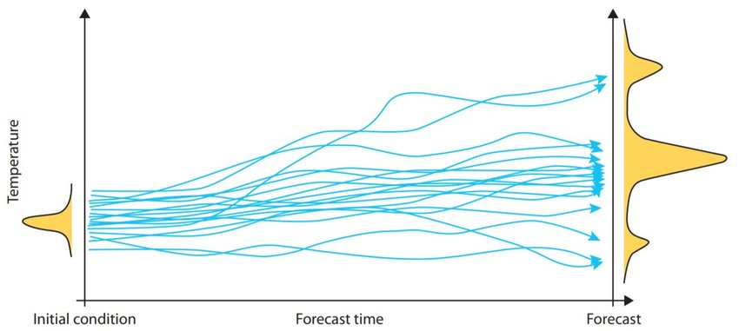
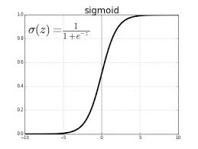
Algorithmic Improvements

Slide 19
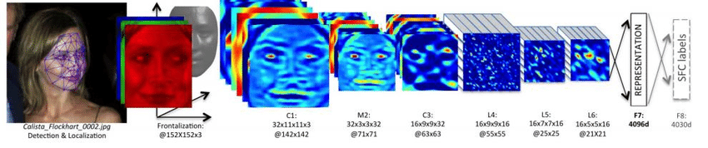
When to Learn Deeply (vs. Not)
COMPLEX RELATIONSHIPS
Complex, non-linear, interactive relationships and mappings; common use cases involve unstructured (high dimensional) data. Deep learning techniques remove the need for feature engineering, a daunting task.

Slide 20
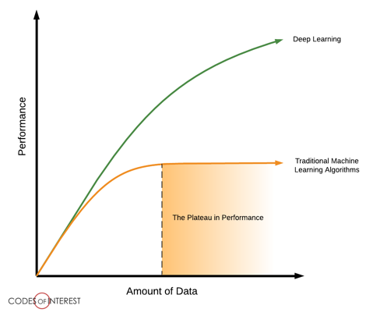
When to Learn Deeply (vs. Not)
LOTS OF DATA ON HAND
To be able to learn those complex mappings, typically requires many, many, many training examples.

Slide 21
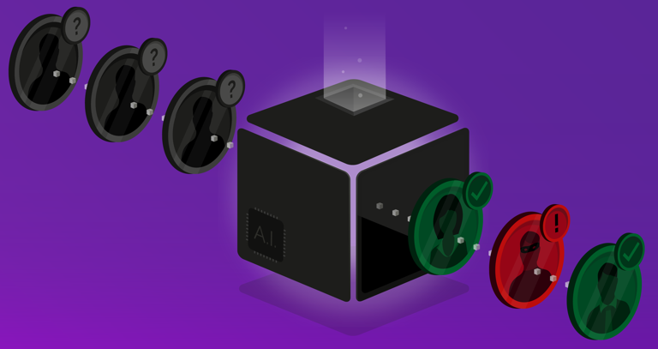
When to Learn Deeply (vs. Not)
LITTLE NEED FOR UNDERSTANDING
Although there have been advancements in explainable and interpretable AI, deep nets are notoriously “black box” algorithms.

Slide 22


Slide 23
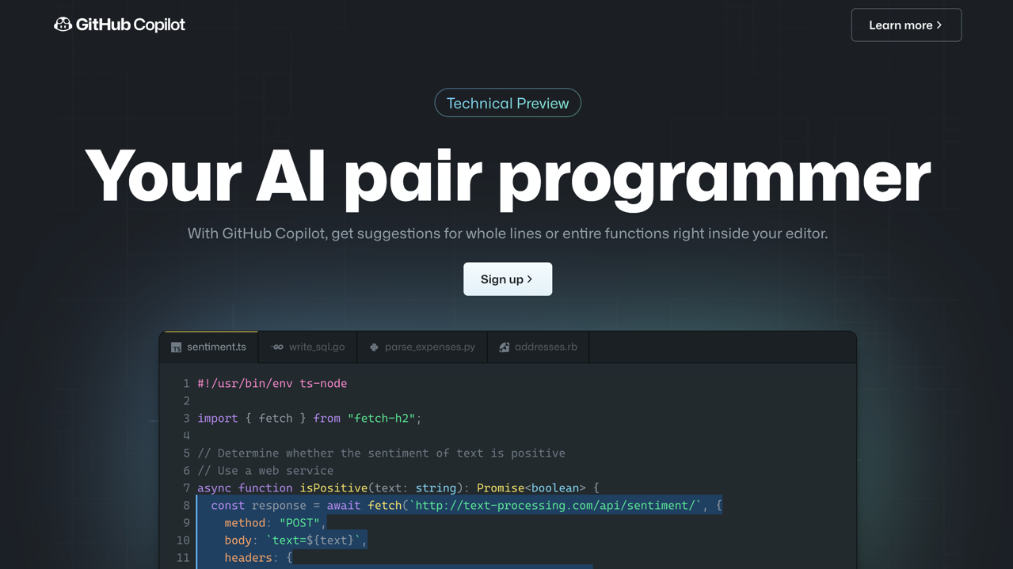

Slide 24
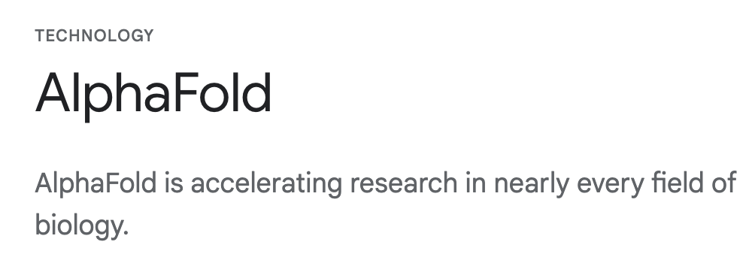

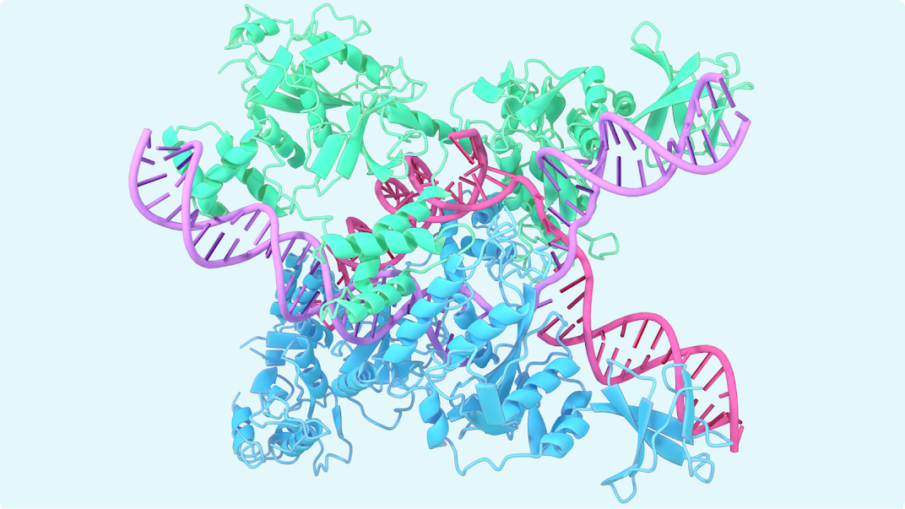

Slide 25
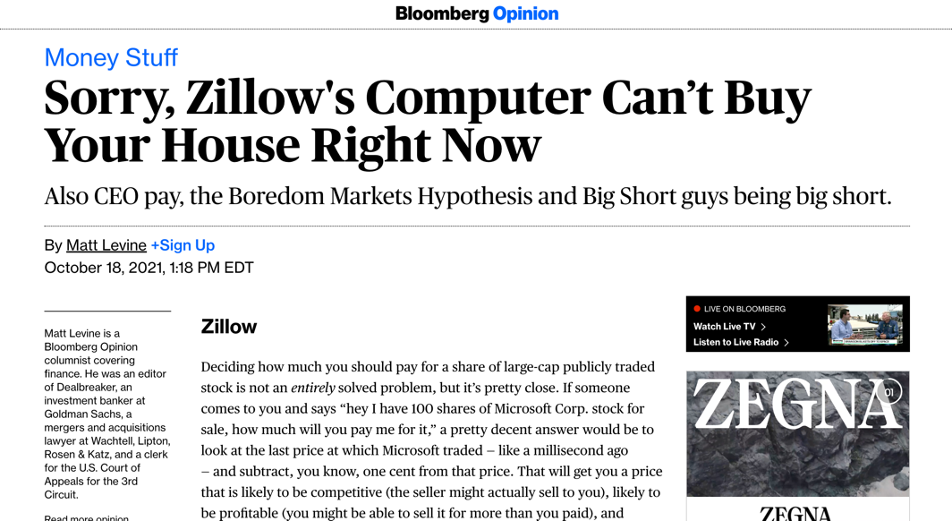

Slide 26


Slide 27
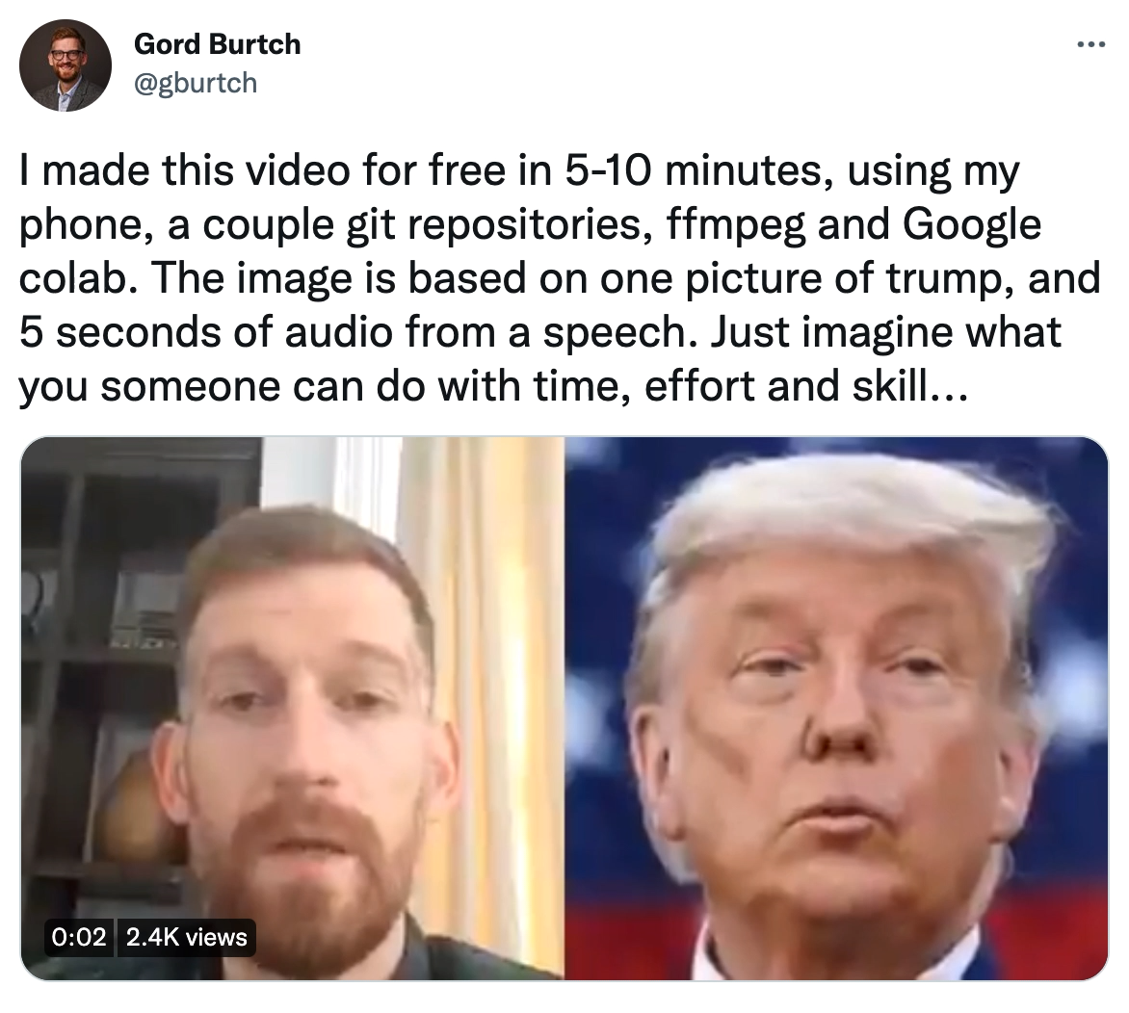
https://twitter.com/gburtch/status/1366806289192517634

Slide 28
How Neural Nets Work, Conceptually

Slide 29
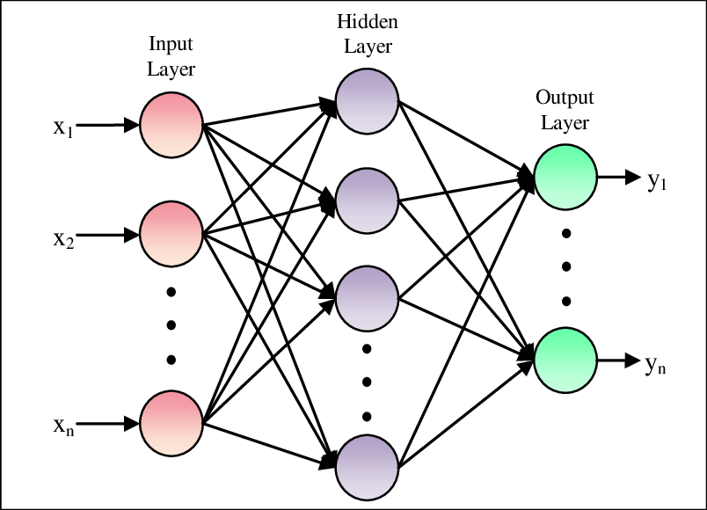
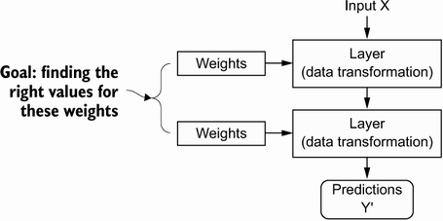
Model Parameters

Slide 30
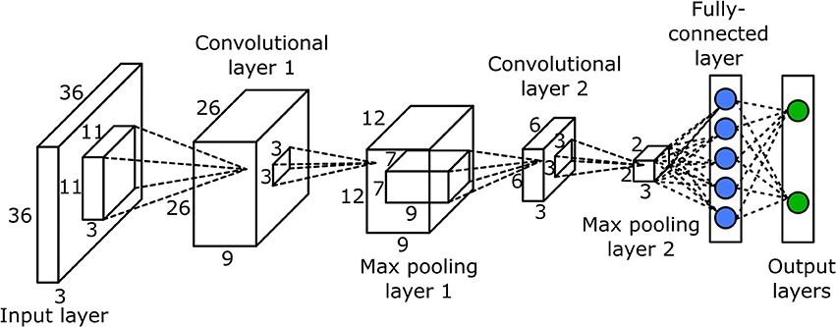
Neural Network Layers
Layers are the Key Building Block of NNs
Dense layers are the simplest form, layers.Dense(), but there are others, e.g., convolutional layers, max-pooling layers, recurrent layers, and so on: https://keras.io/api/layers/.
These are different architectural components that can be mixed and matched in different ways to create different network topologies. It is also possible to construct custom layers.

Slide 31
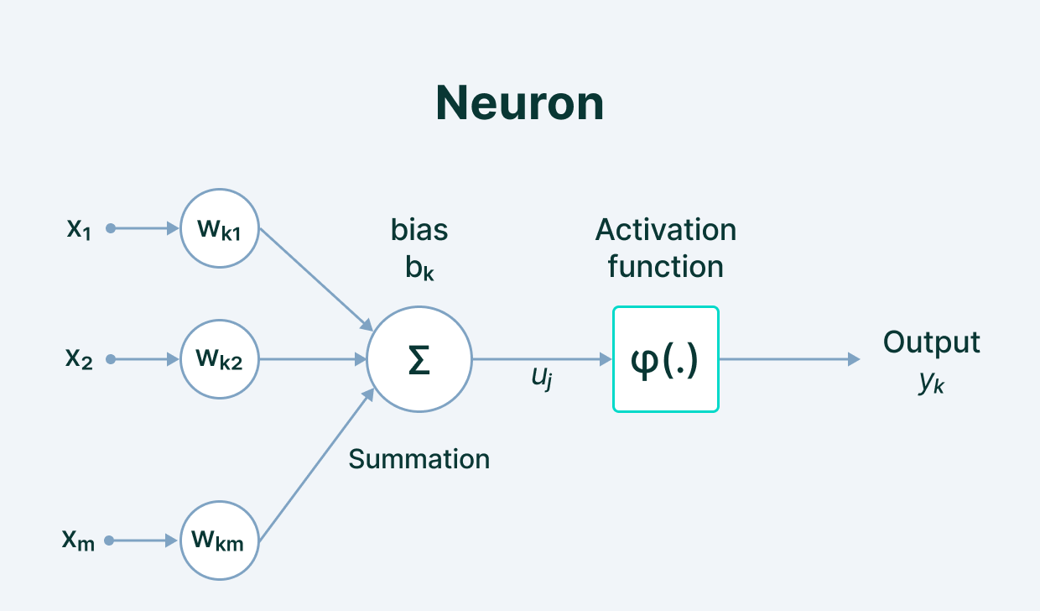
Model Parameters
Notes:
We define the network structure (layers / nodes / edges) and the activate functions (within each node). Our data, X and Y (inputs and labels) are given. Our goal is then to “learn” the remaining parameters, i.e., the w’s and b’s.

Slide 32
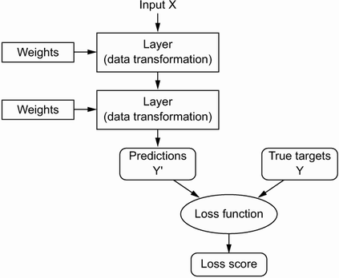
Loss Function (Error)
Notes:
How do we learn the parameters? We need a way to quantify how well we are doing. This is what the loss function is for; it informs our optimization about how ”optimal” our current set of parameter values is.

Slide 33
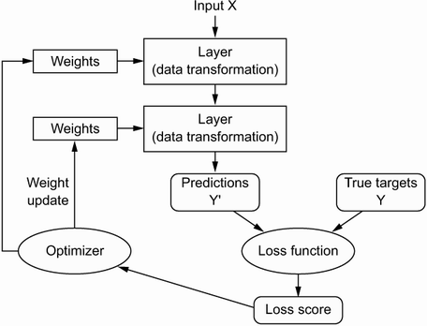
Optimization
Notes:
How do we implement the learning (optimization)? Gradient descent. We identify where we are on the loss curve, figure out a first derivative along all available dimensions (i.e., along all parameters), and proceed where the gradient is most negative (i.e., where the loss function progresses most rapidly toward zero. For this to work, we need to be able to figure out the gradient along each dimension (for each parameter) in a computationally efficient way (remember, some of the biggest models have thousands or millions of parameters!).

Slide 34
Questions?

Slide 35

First Example

